Slide 1
Python – Introduction & IDE
ICT Learning Centre @ UL - Python and ML Foundations

Slide 2

Introduction to Python
A high-level, versatile programming language

Slide 3
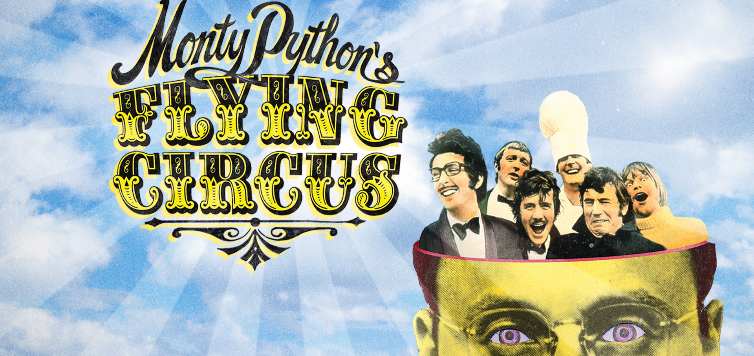
What is Python?
High-level
Versatile
Intuitive syntax
Fun fact:
Named after Guido Van Rossum’s favourite British comedy troupe, Monty Python’s Flying Circus!

Slide 4

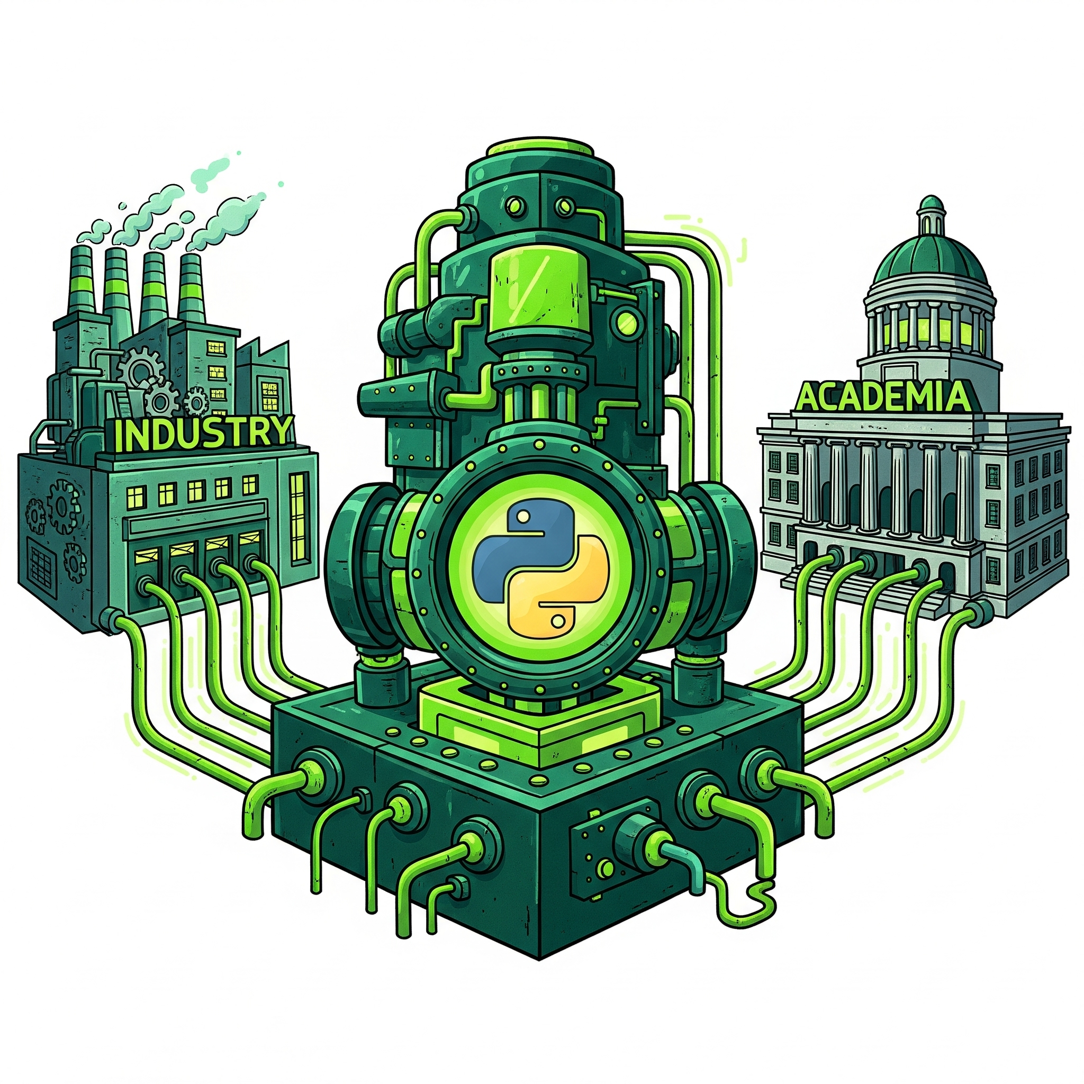
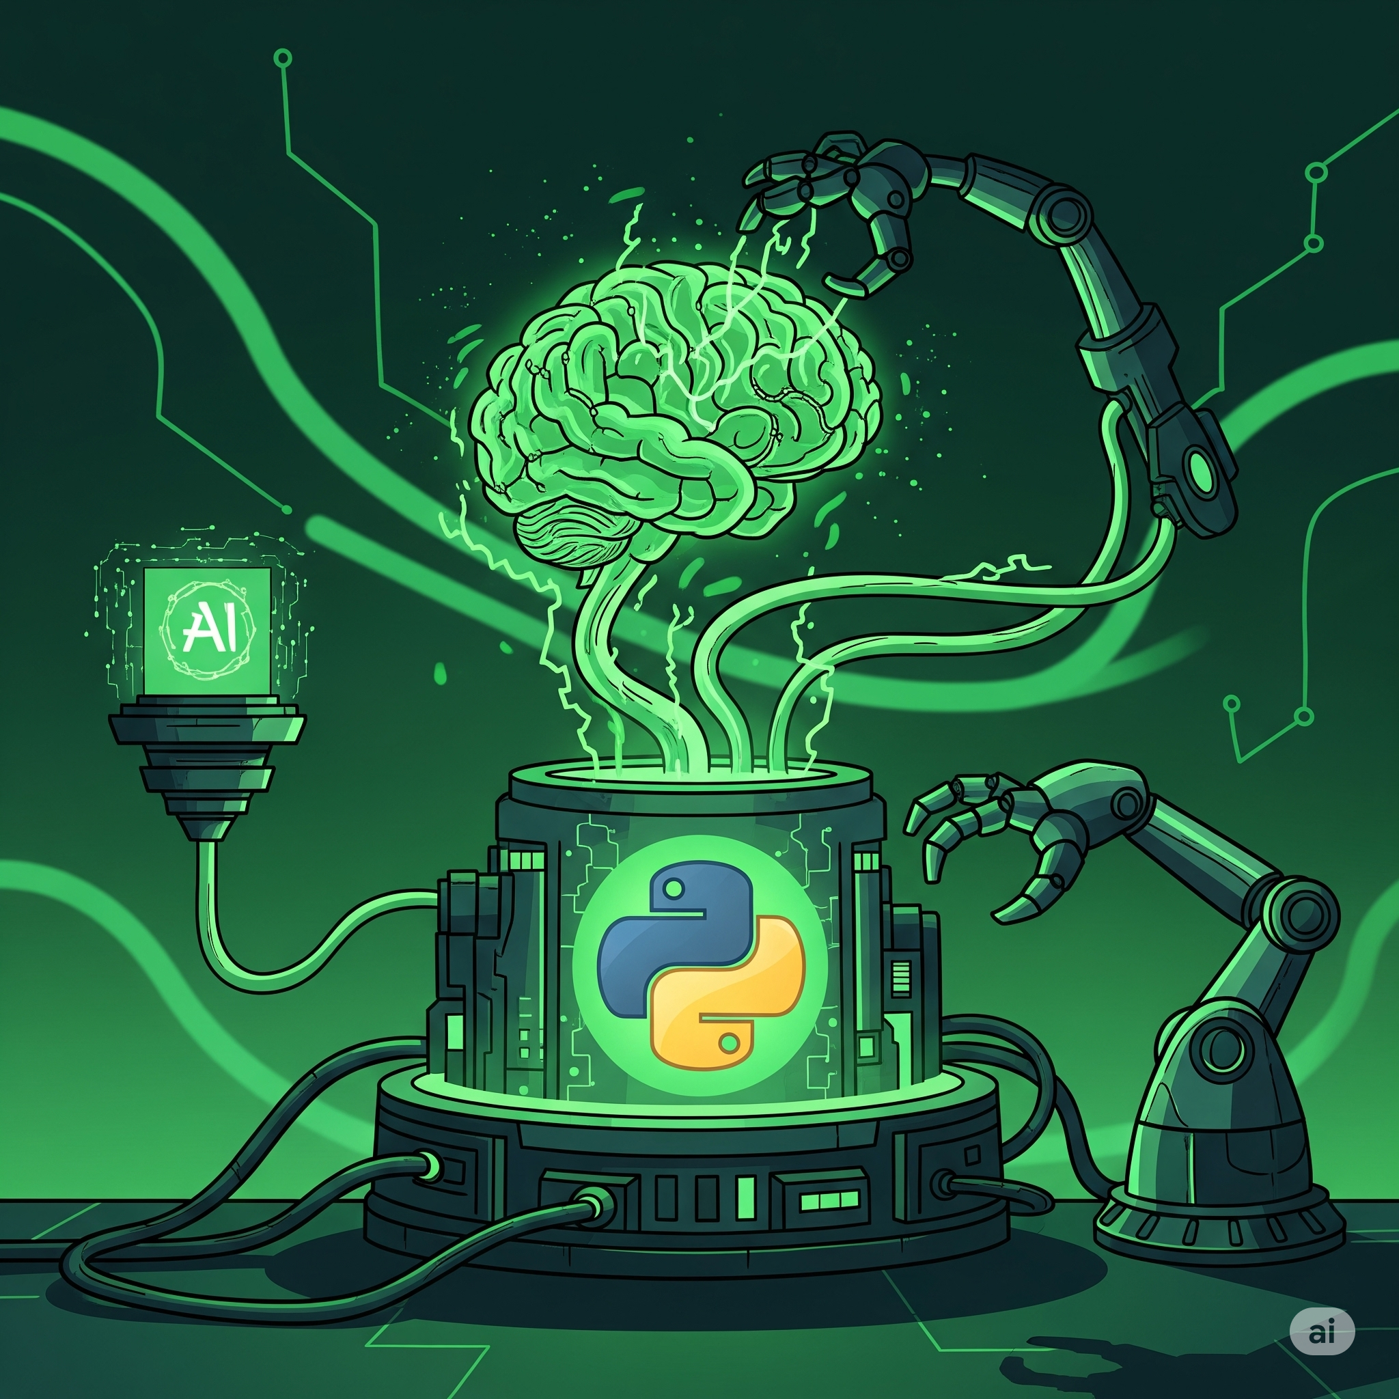
Why Python?
Dominant in industry and academia
Language of choice for AI & ML
Versatile and easy to learn
Powerful libraries and ecosystem

Slide 5

IDE – Google Colab
Your python workspace

Slide 6
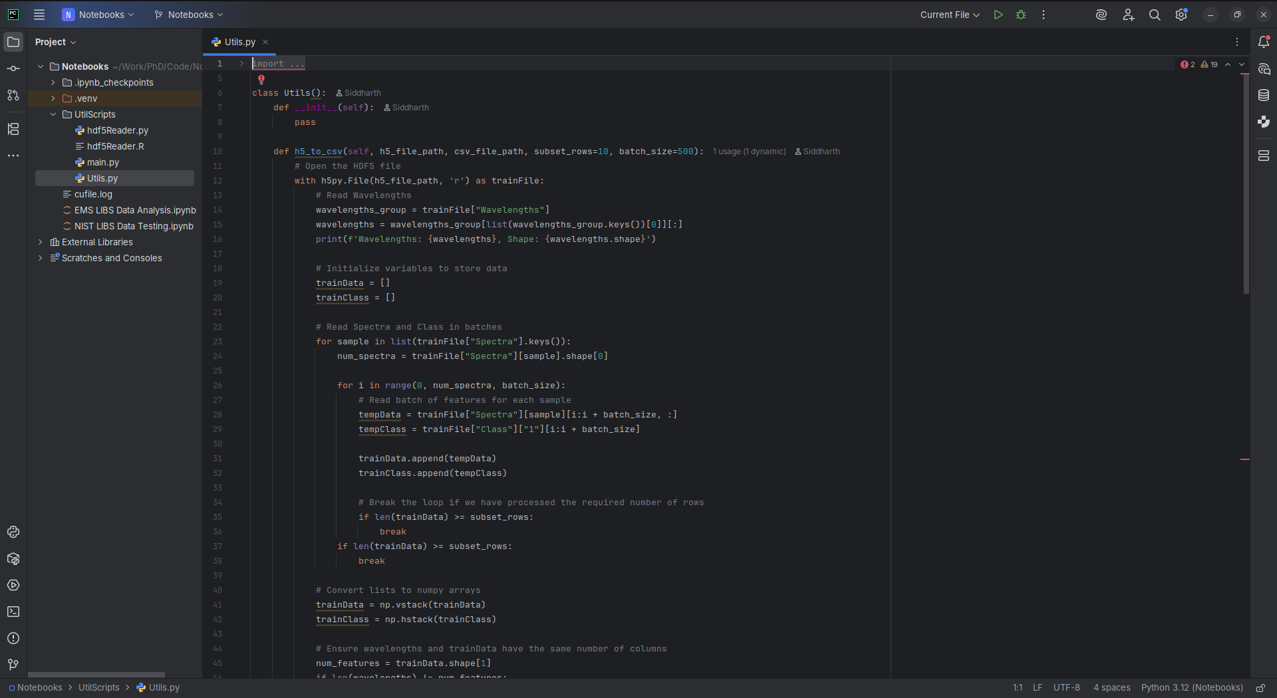
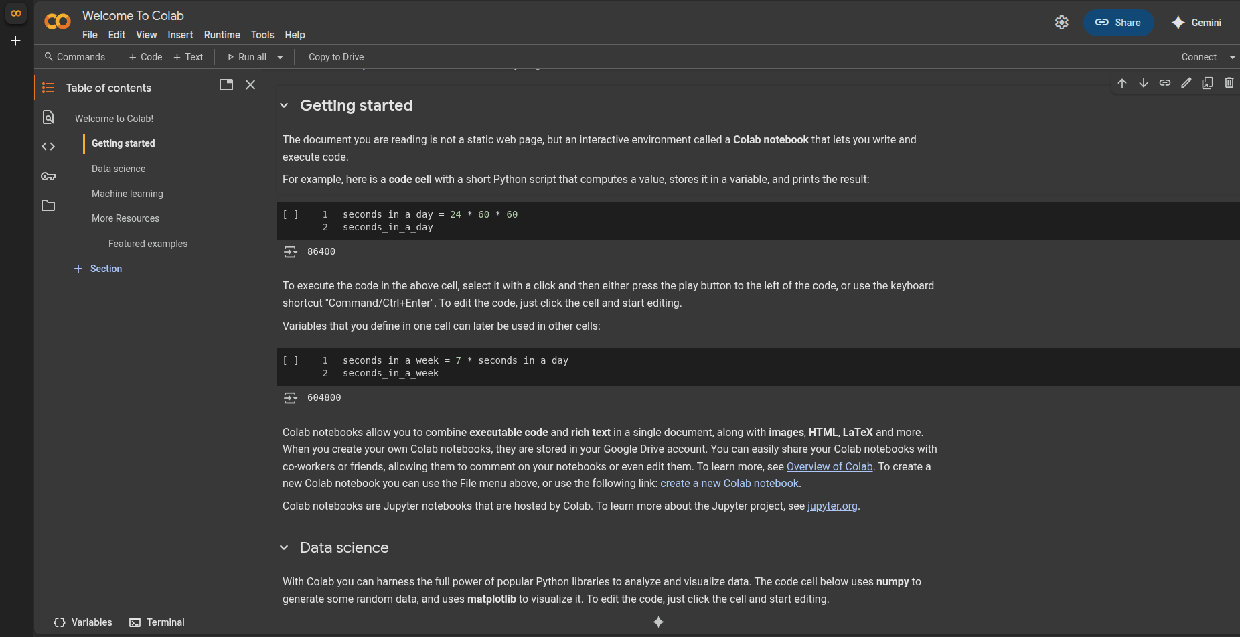
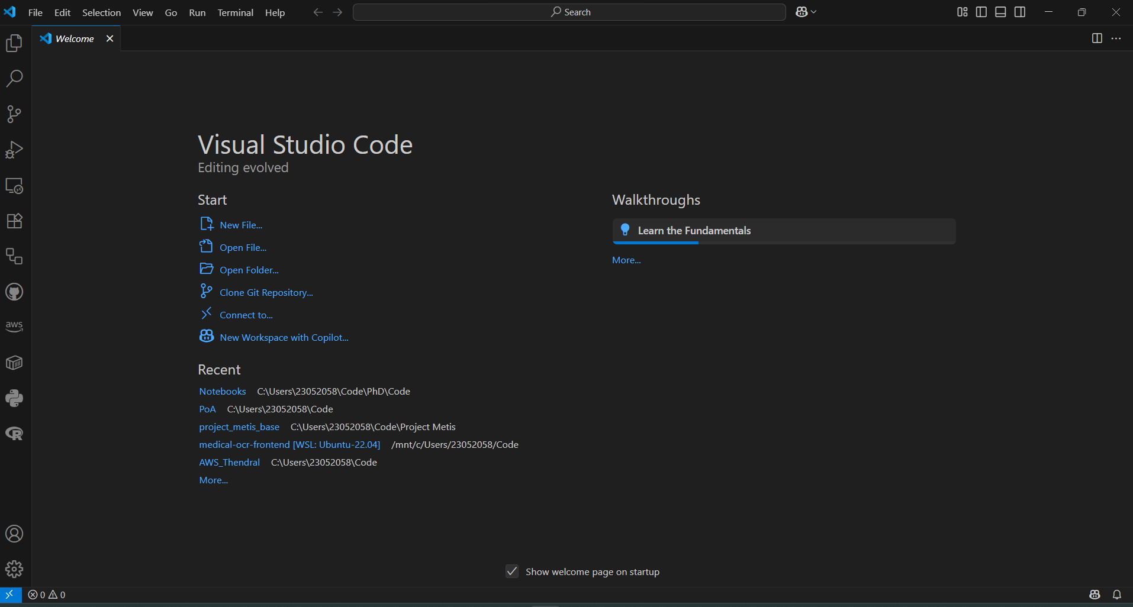
What is an IDE?
Integrated Development Environment
A programmer’s workshop

Slide 7
Google Colab(oratory)

Slide 8
Thank you
ICT Learning Centre,
CS1-046,
CSIS Building,
University of Limerick,
http://ictlc.ul.ie/contactus

